Slide 1
Introduction to Database
Lecture 2

Slide 2
Database Design Process
It refers to a particular database and the associated programs that implement the database queries and updates.

Slide 3
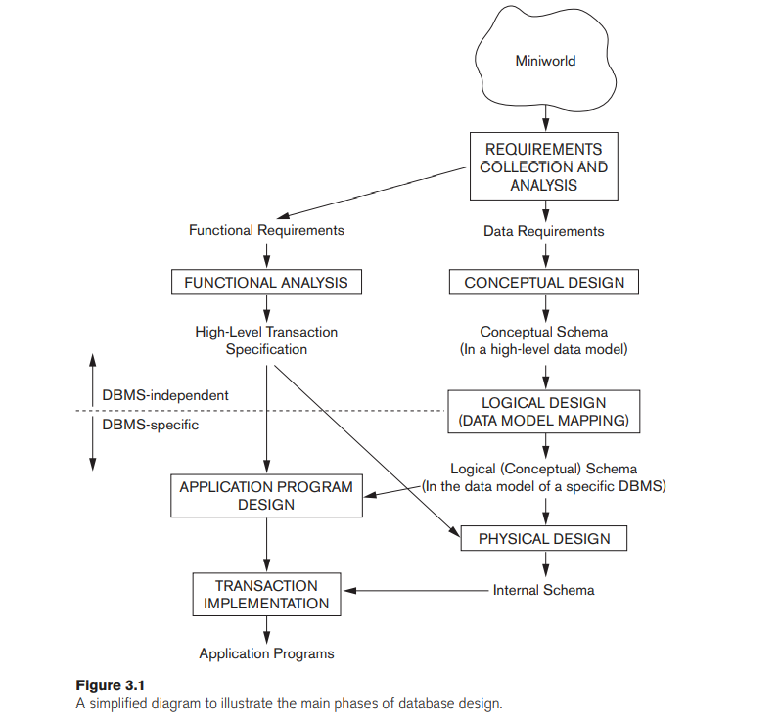

Slide 4
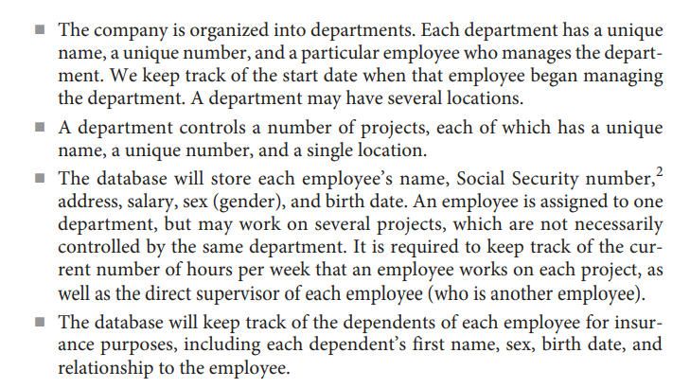
Example

Slide 5
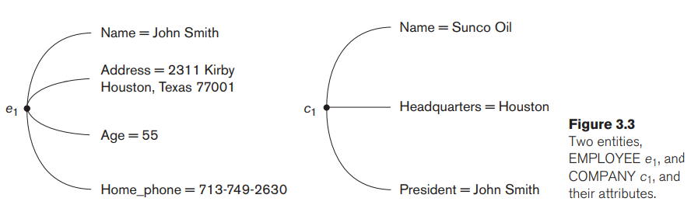
Entity Types, Entity Sets, Attributes, Keys
Entity – A thing or an object in the real world with an independent existence either physical or conceptual.
Attribute – The particular properties that describe the entity.

Slide 6
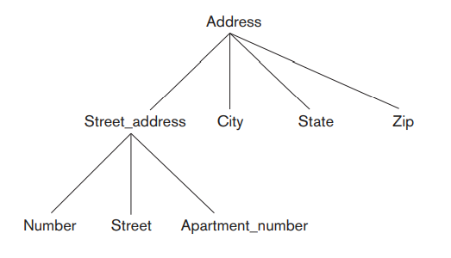
Types of Attributes
Composite VS Simple
Composite Attributes – that can be divided into smaller subparts, representing more basic attributes with independent meanings.
Simple Attributes – that are
not divisible.

Slide 7
Types of Attributes
Single-Values VS Multi-Valued Attributes
Single-Valued Attributes – that have a single value for a particular entity.
Multi-Valued Attributes – that have multiple values but they have lower and upper bounds to constrain the number of values.

Slide 8
Types of Attributes
Stored VS Derived Attributes
Derived Attributes – that can be determined/derived from other attributes.
Stored Attributes – from which the other attributes are derived.
NULL Valued Attributes
An entity not having an applicable value for an attribute.

Slide 9

Types of Attributes
Complex Attributes
The grouping of composite attributes between parentheses () and multivalued attributes between braces {}.

Slide 10
Entity Types and Entity Sets
Entity Type – A collection/set of entities with same attributes.
Entity Set – The collection of all entities of a particular entity type in the database at any point

Slide 11
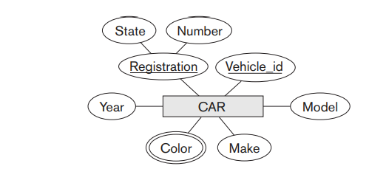
Key Attributes of an Entity Type
One or more attributes whose values are distinct for each individual entity in the entity set.

Slide 12
Value Sets (Domains) of Attribute
The set of values that may be assigned to the specific attribute for each individual entity.
Basic Function
A : E → P(V)
Composite Value Attribute
V = P(P(V₁) × P(V₂) × . . . × P(V_{n}))

Slide 13
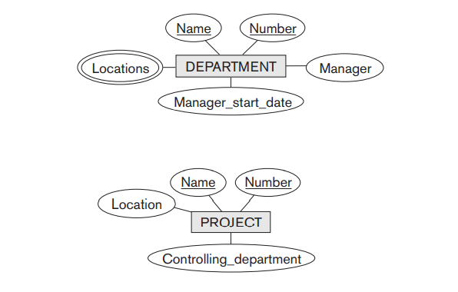
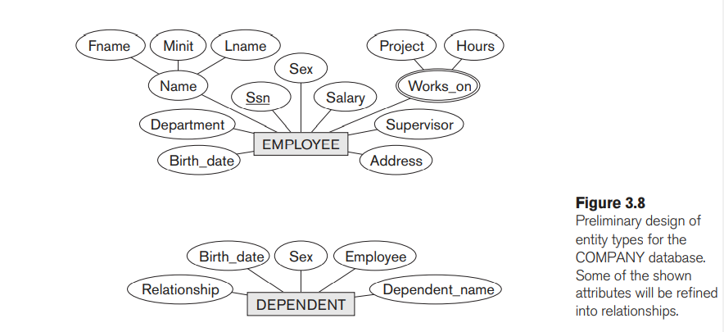

Slide 14
Relationship Types, Relationship Sets and Instances
Relationship Type – identifies the relationship name and participating entity types with certain constraints.
Relationship Set – The collection of relationship instances represented in the database.

Slide 15
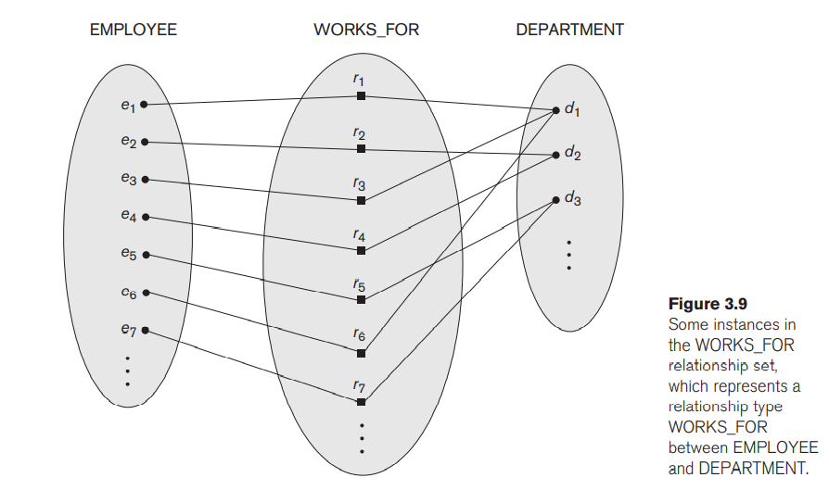

Slide 16
Relationship Degree
The number of participating entity types.
Binary – A relationship type with degree two.
Ternary – A relationship type with degree three.

Slide 17
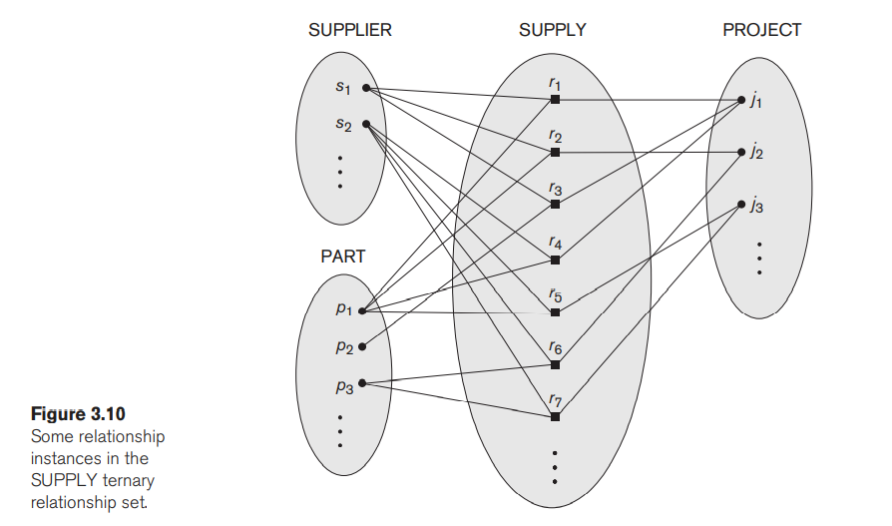

Slide 18
Constraints
Limits the possible combinations of entities that may participate in the corresponding relationship set.
Cardinality Ratio constraint – The maximum number of relationship instances that an entity can participate in.
Participation Constraint – The minimum number of relationship instances that an entity can participate in.
Structural Constraint – Both above constraints when taken together.

Slide 19
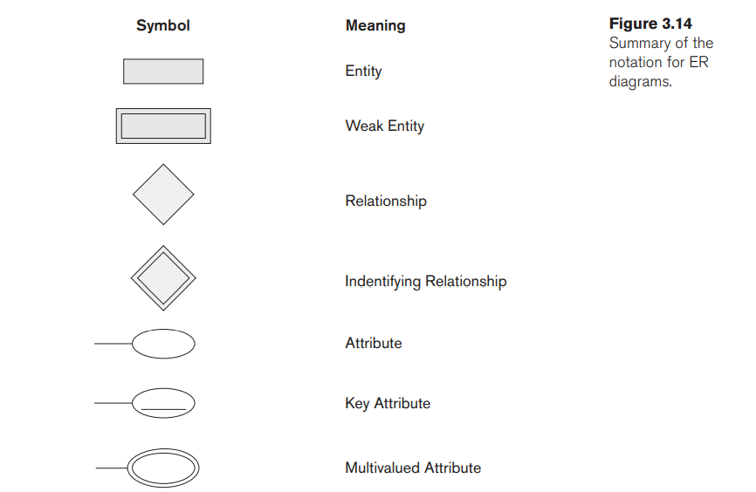

Slide 20
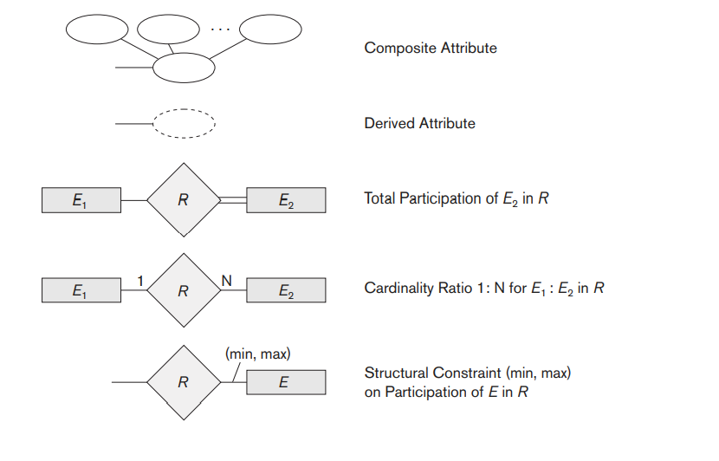

Slide 21
